Slide 1





基于数字孪生的智慧能源系统
Planoras Energy Concept and Digital Twin are results of 35 years development
done by Planora Oy

Slide 2
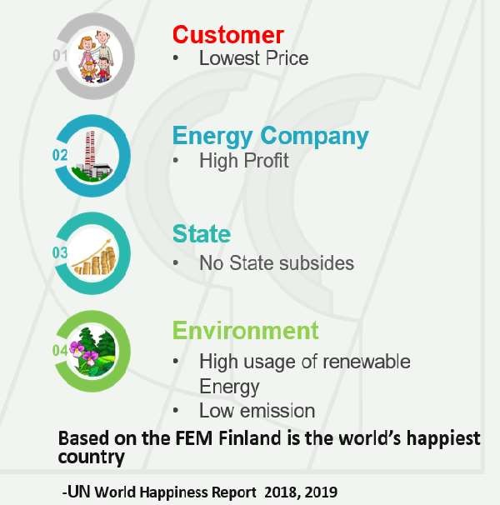
Planoras Energy Concept FEM - Digital Twin
Planoras Energy Concept takes care of every object of an energy system (customers, networks, different energy sources) and optimizes the operation of the whole system, not only a part of it.
This concept creates happines to
This concept creates
Tax revenues for State and Areas
Profitable Operation for Energy Utilities
Savings in State and Areas budgets
Savings in Investments
Savings in Operation
Positive environmental impacts
Foundation for Smart Energy Utilities and Cities
Foundation for ICT and IoT operation
Words best key indicator figures of the energy sector

Slide 3
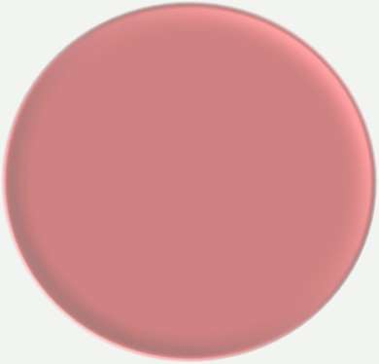






Planora Services - Digital Twin
The solution to reach the efficient figures of the Finnish Energy Sector
Correct information in the right place and stored and displayed in the right way
Real-time data combined in the same service
To manage the whole system better
Web Platfrom
DIGITAL TWIN: The Foundation for operation and services

Slide 4
Planoras Services - Digital Twin
Planoras services
-in establishing the Digital Twin
-in optimization of the district heating system
-in design of the district heating system
-in design of differen heating sources
-in providing super secure data transfer
-to minimize cost of operation utilizing three control points
-to share data between different applications
-to share data between different companies
-to integrate data from different sources
-to create ecosystem for different services

Slide 5
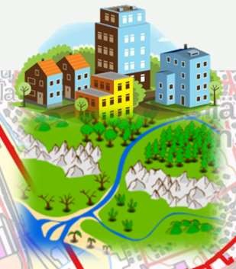
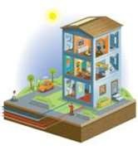
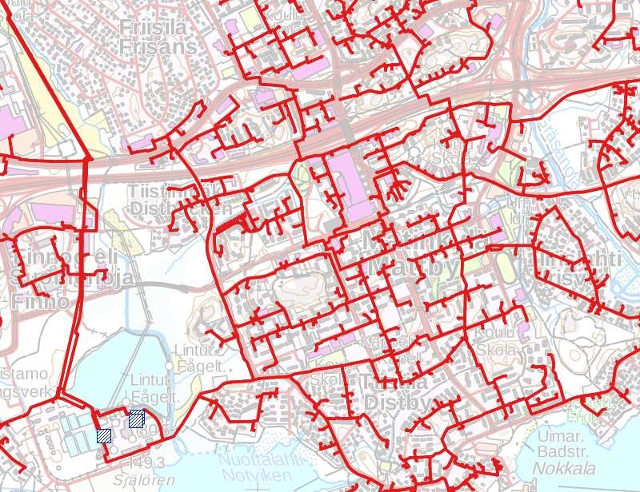
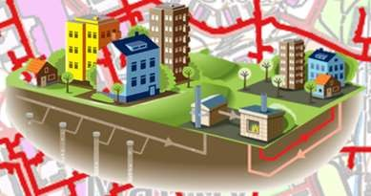
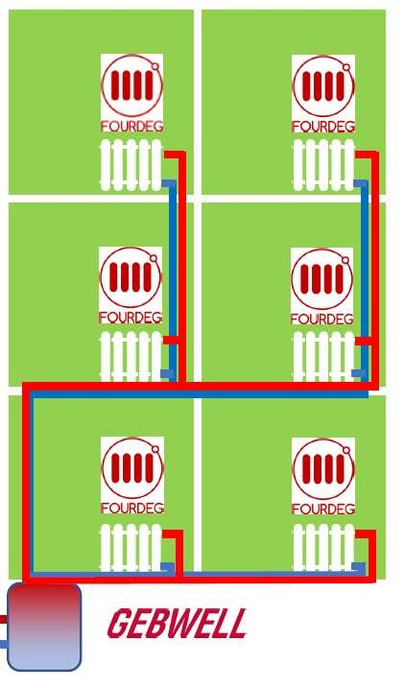

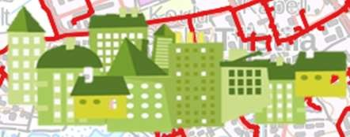
Digital Twin; the foundation of an Energy company
Design and Data Processing phase to create the Digital Twin
The DHC-company’s network data (customers, pipes, and facilities) are processed to create the Digital Twin. This digital twin can be used for example in
D I G I T A L
network calculation
long-term planning
provided by different companies
-
This Digital Twin is the foundation for effective operation and for all activities of a heating utility
T W I N

Slide 6
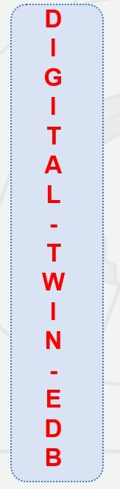
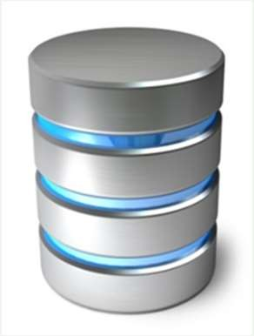
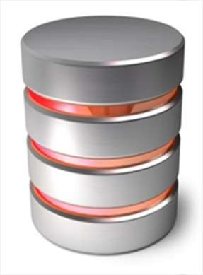
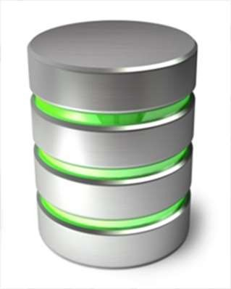



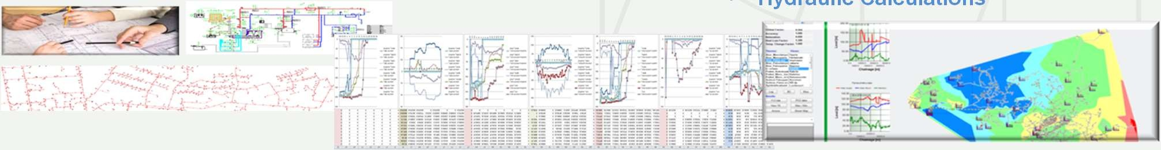
Development phases of Digital Twin
Processing network information for design, calculation, cloud and web services
EDB 0 EDB 1
EDB 2
Data transfer to database
Can be utilized in
Different web service
Topological review
Can be utilized in
Different web service
Calibration of network
Can be utilized in
Different web service
Hydraulic Calculations

Slide 7
Benefits of Digital Twin
Digital twin is the foundation for all activities of an energy company Digital twin is utilized in
Hydraulic calculation
In design of heating network and different plants Preparing the development plan for a heating company
Information received from different IoT points can be properly utilised in desing
in operation of the heating company in different applications
Information of the heating company can be shared between Different Companies
Different applications Digital Twin utilizes NoSQL Data Sea

Slide 8
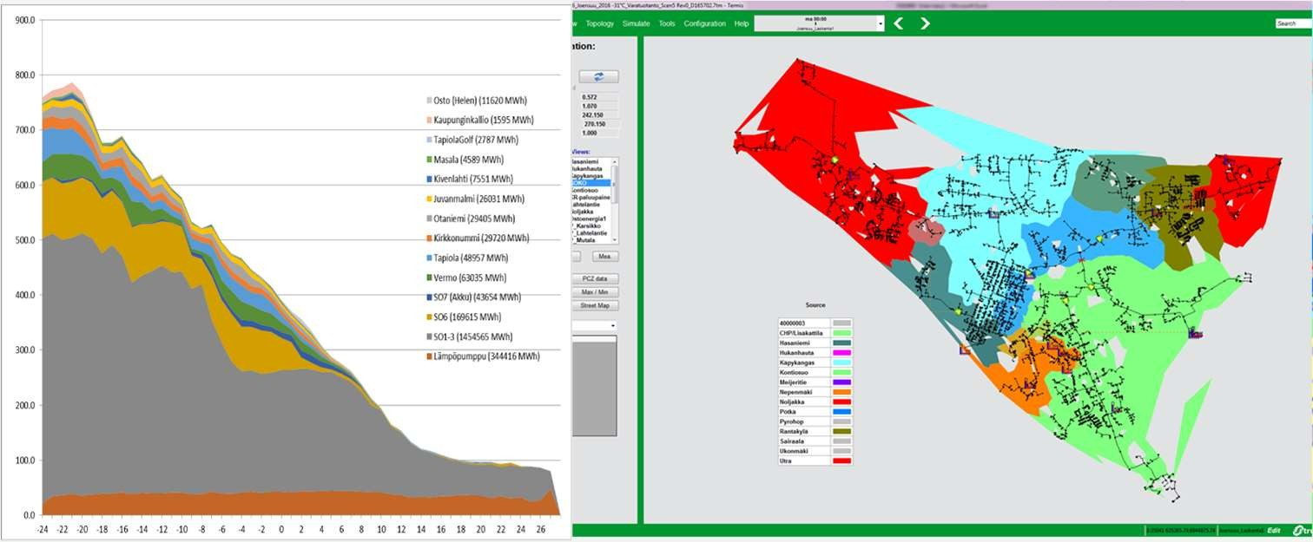
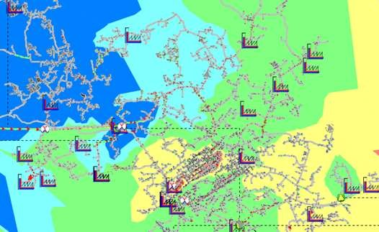
Utilize the created Digital Twin in different hydraulic calculations
Utilization of network calculation
O ptimization of heat production based on the cost price of thermal e nergy and electrical energy selling price
Abnormal heat production simulation
Network downtime simulation
Optimization of pumping and pressure levels
Optimization of the flow temperature and the minimization of network losses

Slide 9
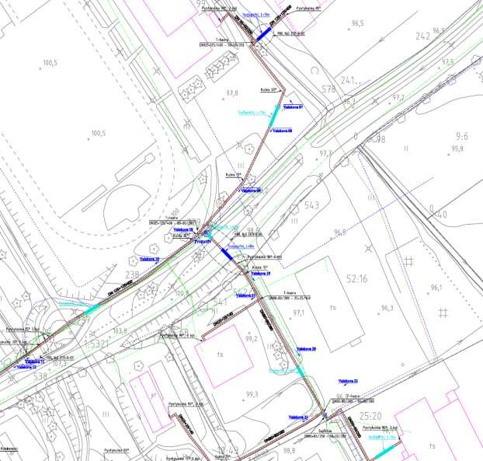
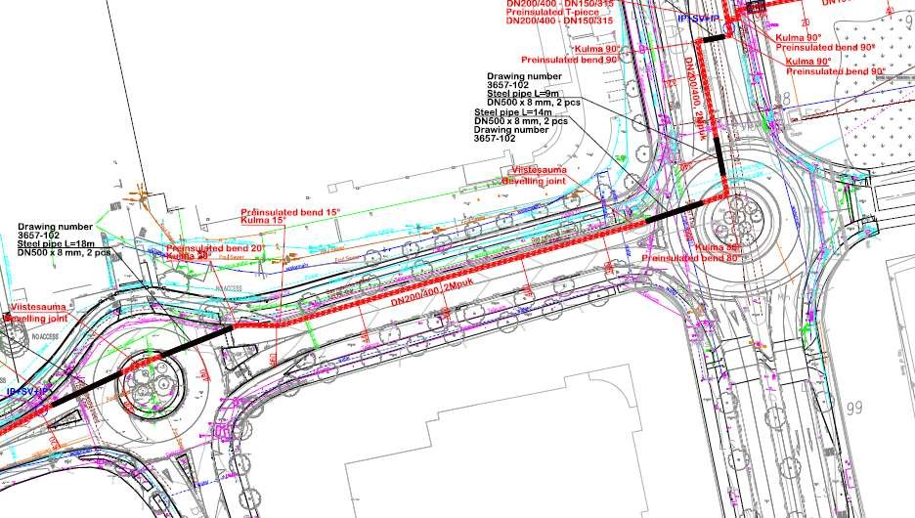
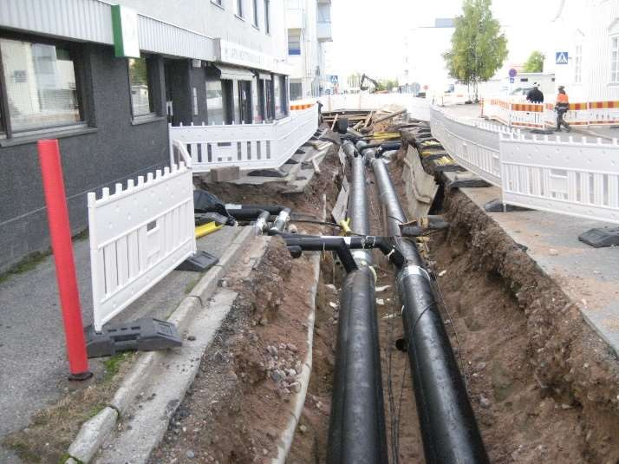
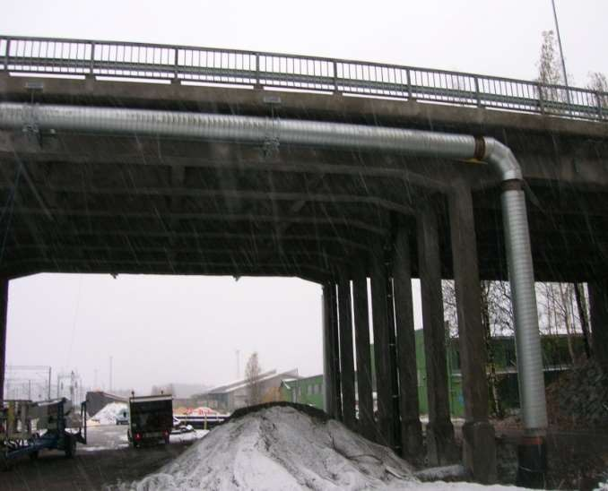
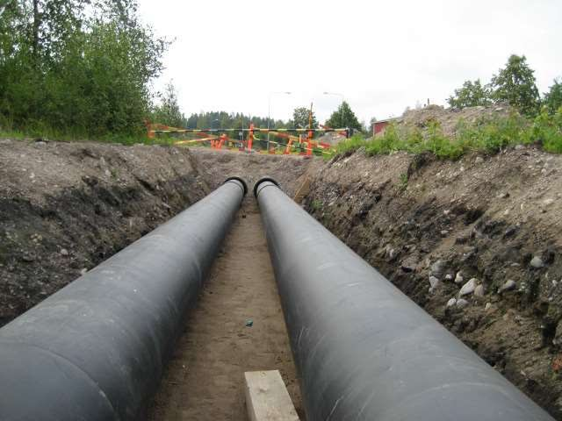
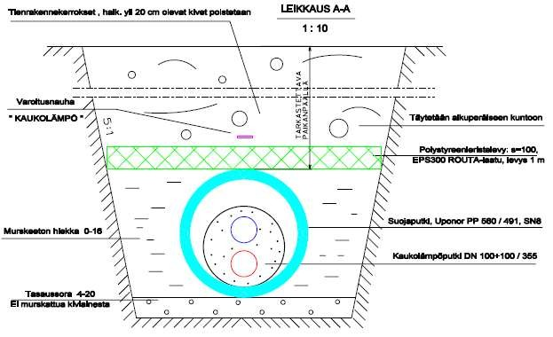
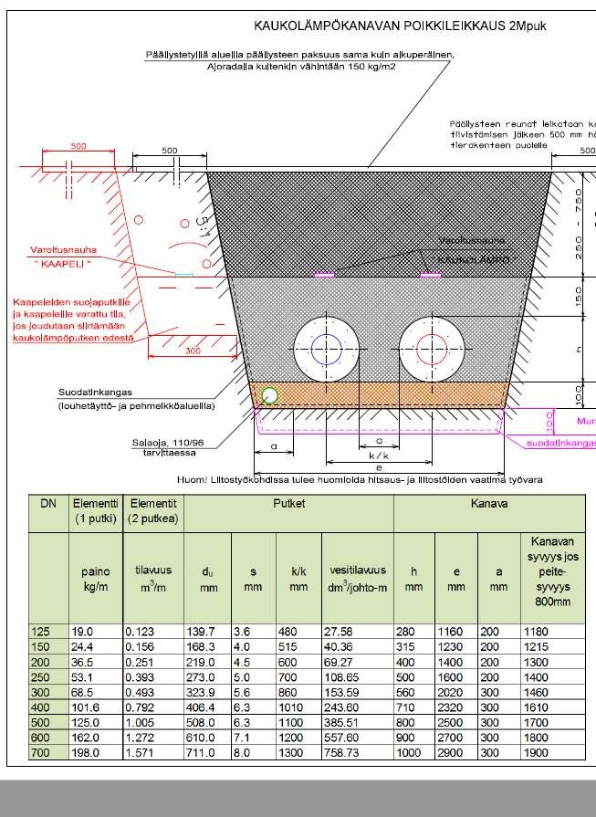
Utilize the created Digital Twin in Network Design

Slide 10
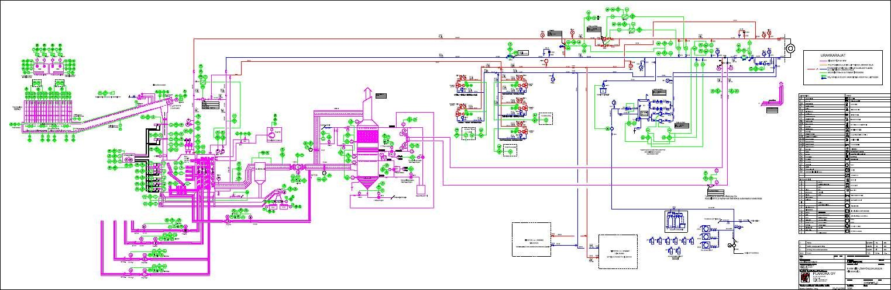
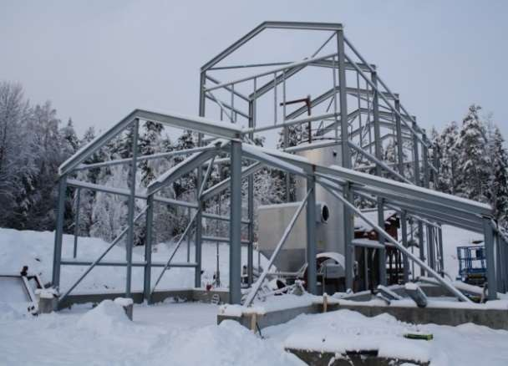
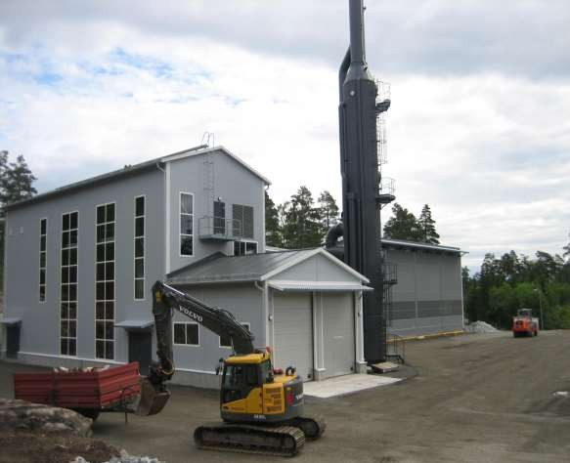
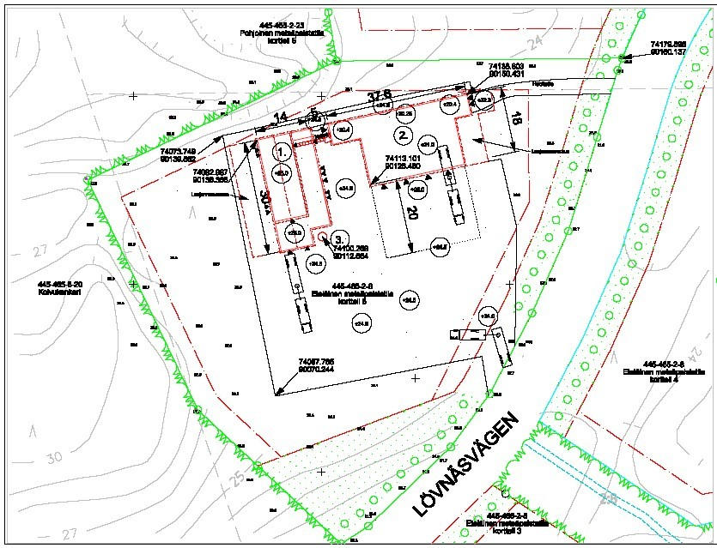
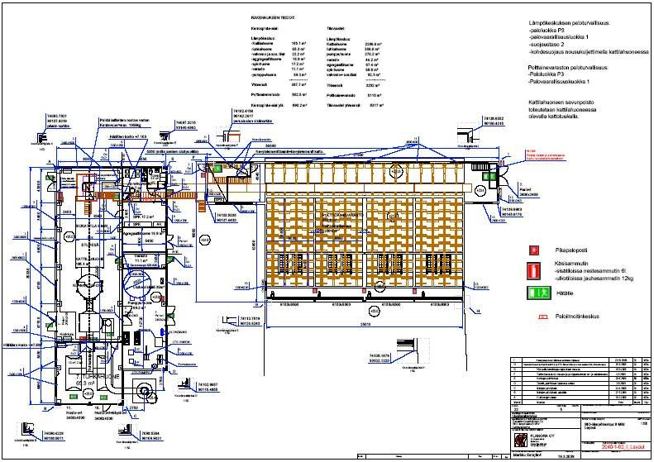
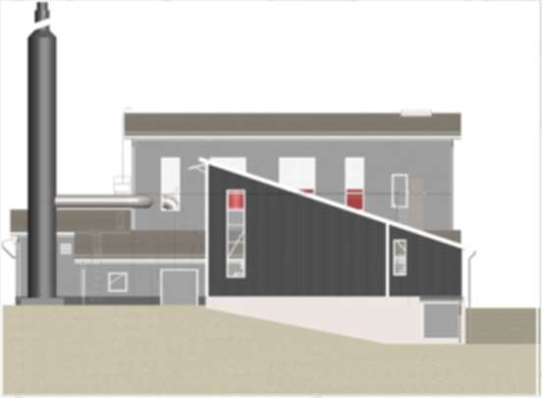
Utilize the created Digital Twin in Boiler Plant Design
Paraisten Kaukolämpö Oy, Finland, 2010 – design of a new boiler plant construction 8 MW (biofuels – wood chips) + 2 MW flue gas scrubber

Slide 11

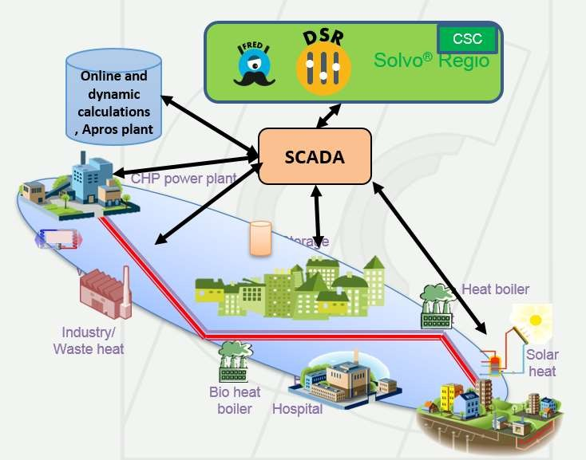
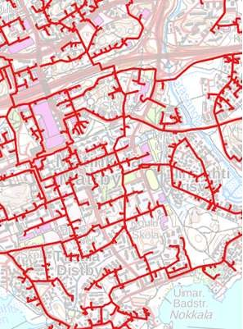
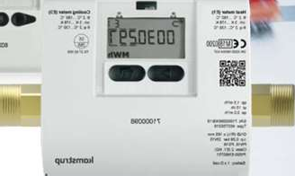
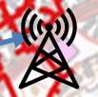
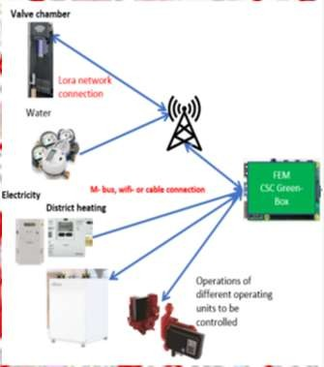

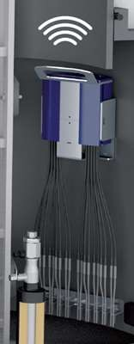
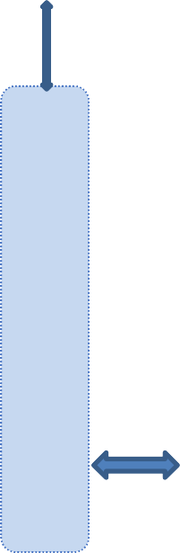

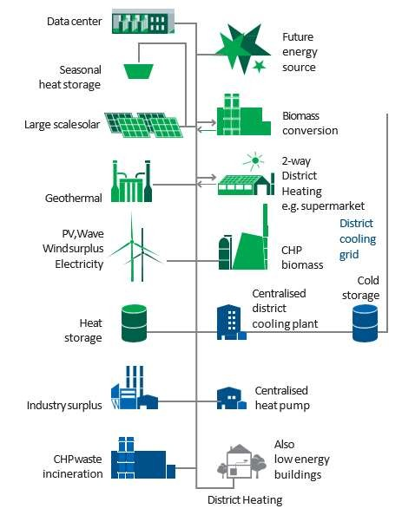

Integrate data from different sources to supervise a heating utility
IoT and control points in different networks
Operations management
Online and dynamic calculations
D I G I T A L
Different networks, heating, cooling, water, electricity
Network data reconfiguration for Apros
-
Design and off- line calcula- tions
T W I N
User Connections
CSC

Slide 12
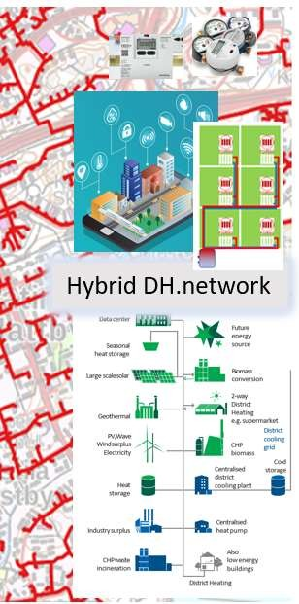

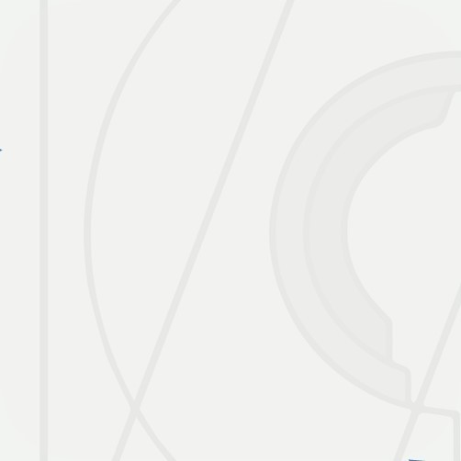



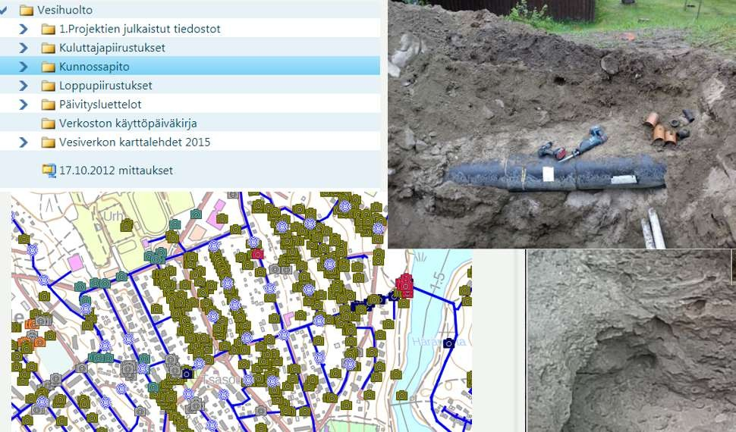

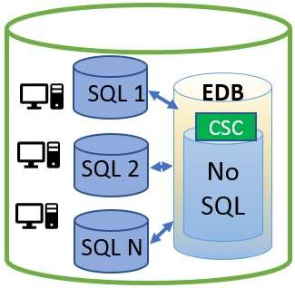
Create an Ecosystem based on Digital twin
Different networks and IoT points
Data Sea
Creating Digital Twin and integeration of data from different IoT points and Cloud services
Connections of Inputs/Outputs to different customer
Off line and dynamic calculations
D I G I T A L
CSC- G
Connection of different API, ABI or Wasm -services provided by companies joined to the Ecosystem
-
T W I N
Company A
Company B
Company N

Slide 13



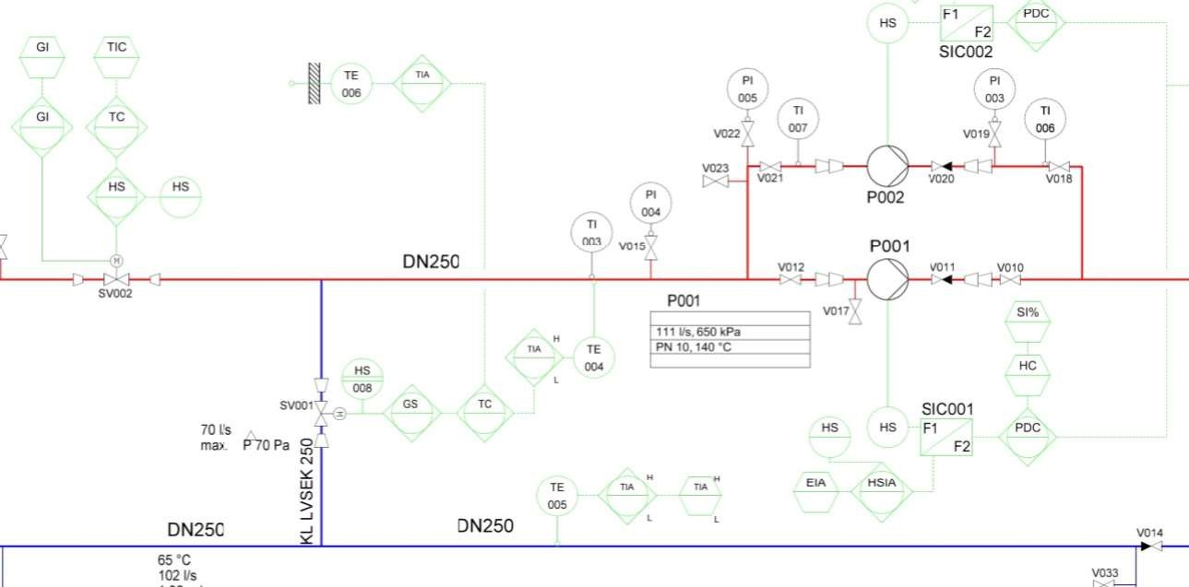


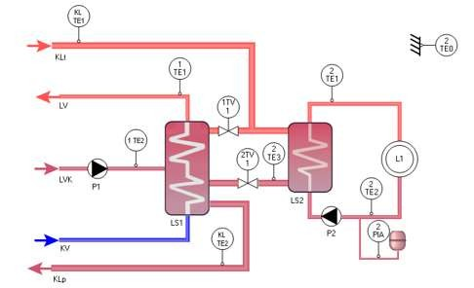
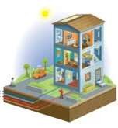




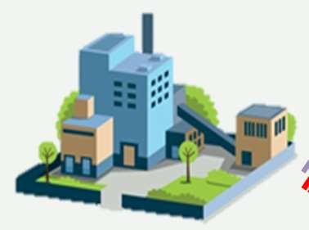







An example how to improve operation of DH-companies Digital Twin and three control points application. Patent accepted
FEM Cloud Service for
Room thermostat valves to control room temperature
Heat substation to control water temperature into the buildings heating network
FEM provides Smart Heating and Living
District heating network
to control
water temperature from a plant
into the network
CSC-G
FEM Cloud Service
Hybrid District Heating Smart Heating System
CHP plant
CSC-G
Peak Heat boilers
DH Storage
CSC-G
Pumping stations
Hospital
Bio heat boilers
Data Centers
DIGITAL TWIN - FEM

Slide 14
Results of Planoras Service based on the three control points
This service improves even more of the Key figures of the Finnish Energy Sector
With Service the
Needed capacity will decrease 10 -20 %
Energy consumption will decrease 10 – 20 %
200
180
160
140
120
100
80
60
40
Heat demands kW
0
2
4
6
8
10
12
Day hours (h)
14
16
18
20
22
24
Heat power with the service kW Heat power without service kW

Slide 15
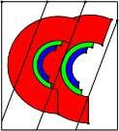


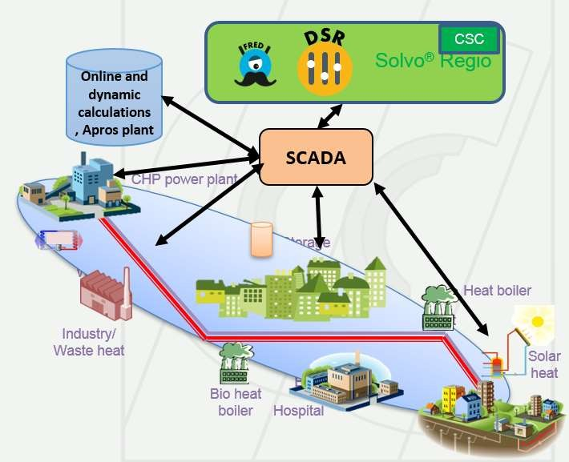
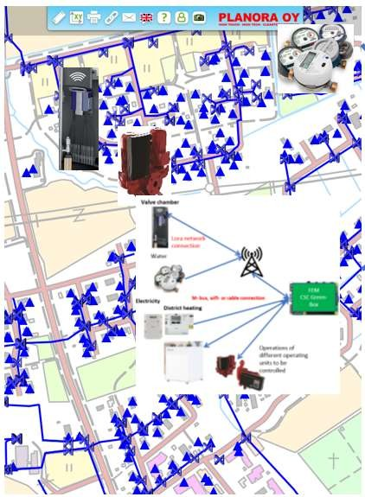
Why to utilize Digital Twin and main four steps
Because it provides the best and most economical solution for operation and Carbon neutral future. Steps to the happy future
STEP 2
Connect all IoT points related to network into the service
STEP 3
Integrate all IoT points to the objects in the digital Twin
STEP 4
Create Ecosystem you prefer and start to utilize it design and operation
STEP 1
Create the Digital Twin of the Hybrid District Heating Network
Connection of different API, ABI or Wasm -services provided by companies joined to the Ecosystem
DATA SEA
DIGITAL TWIN
Company A
Company N

Slide 16
Contact us for more information
Esa Teppo Katja Granlund Yu Li
Han Rongxian
phone : 040 900 6900,
phone : 044 781 9306,
phone : 044 781 9303,
phone : +86 138 1136 1942,
esa.teppo@planora.fi katja.granlund@planora.fi yu.li@planora.fi
hanhar@163.com sami.osterman@planora.fi risto.prokkola@planora.fi
Sami Österman phone : 040 520 4700,
Risto Prokkola phone : 044 422 9604,
www.planora.fi

